Slide 1
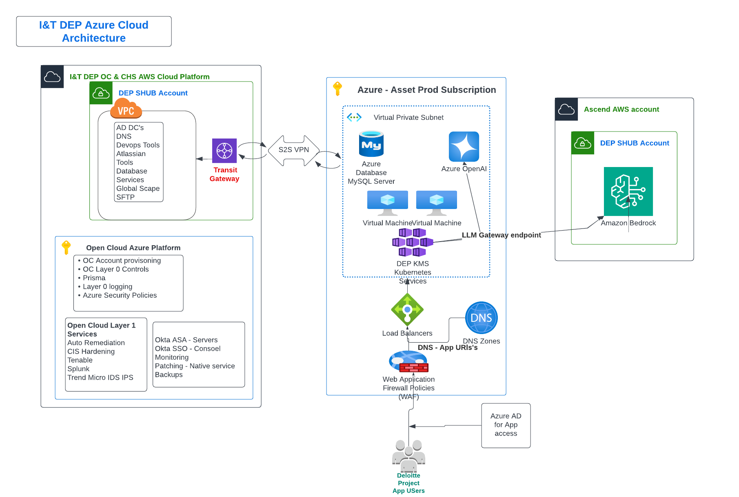
Cloud Infrastructure View - Prod
Approval date (DAS/Audit Cloud Architecture): 10/01/2025 –PXE infrastructure; 09/25/25 - AEF infrastructure approval
Approved by (DAS/Audit Cloud Architecture): Kumar, Ravi—PXE infrastructure
Baumhart, Patrick <pbaumhart@deloitte.com> -AEF infrastructure
Notes:
Updated in v2.3: New review signoff required for this slide. Contact guidance below.
No updates in v2.2
No updates in v2.1
PAR Template Diagrams
https://applicationstandards.deloitte.com/app/core/governance/application
Approval required for this infrastructure view slide
Architects should reach out to their channel aligned Site Reliability Engineer (SRE) with an overview of the solution/requirement, integrations, load model, any/all special requirements. The SRE will coordinate with the cloud infrastructure architect to consult, design the infrastructure, considering approved services and configurations, conduct peer reviews obtain the cloud infrastructure architect’s approval.
Whichever infrastructure slide is used needs to be reviewed and approved by a member of the appropriate Infrastructure Team:
DAS Audit Projects: US AAPS Cloud Architects <usaapscloudarchitects@deloitte.com
All other DAS Projects: US DAS Cloud Infra Architecture <usscmplatformarchitecture@deloitte.com>

Slide 2
